Slide 1


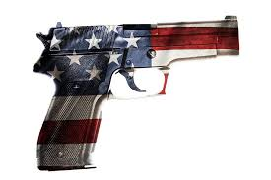
Unsupervised Learning
An Investigation into US Gun Violence
by
Robert Harris

Slide 2
United States – est. 1776
Constitution-based federal republic
Pursuit of liberty, happiness, …
Freedom of religion, speech, …
Right to keep and bear arms (2A).

Slide 3

2nd Amendment:
Abundance of firearms and ammunition.
Unchecked availability:
Criminals
Mentally ill
Etc…

Slide 4

US Gun Violence:
Mass shootings
Armed robbery
Home invasion
Gangs

Slide 5
Task:
Identify Gun Violence Patterns
Develop a machine learning algorithm
Use unsupervised techniques
Cluster Similar attributes.

Slide 6
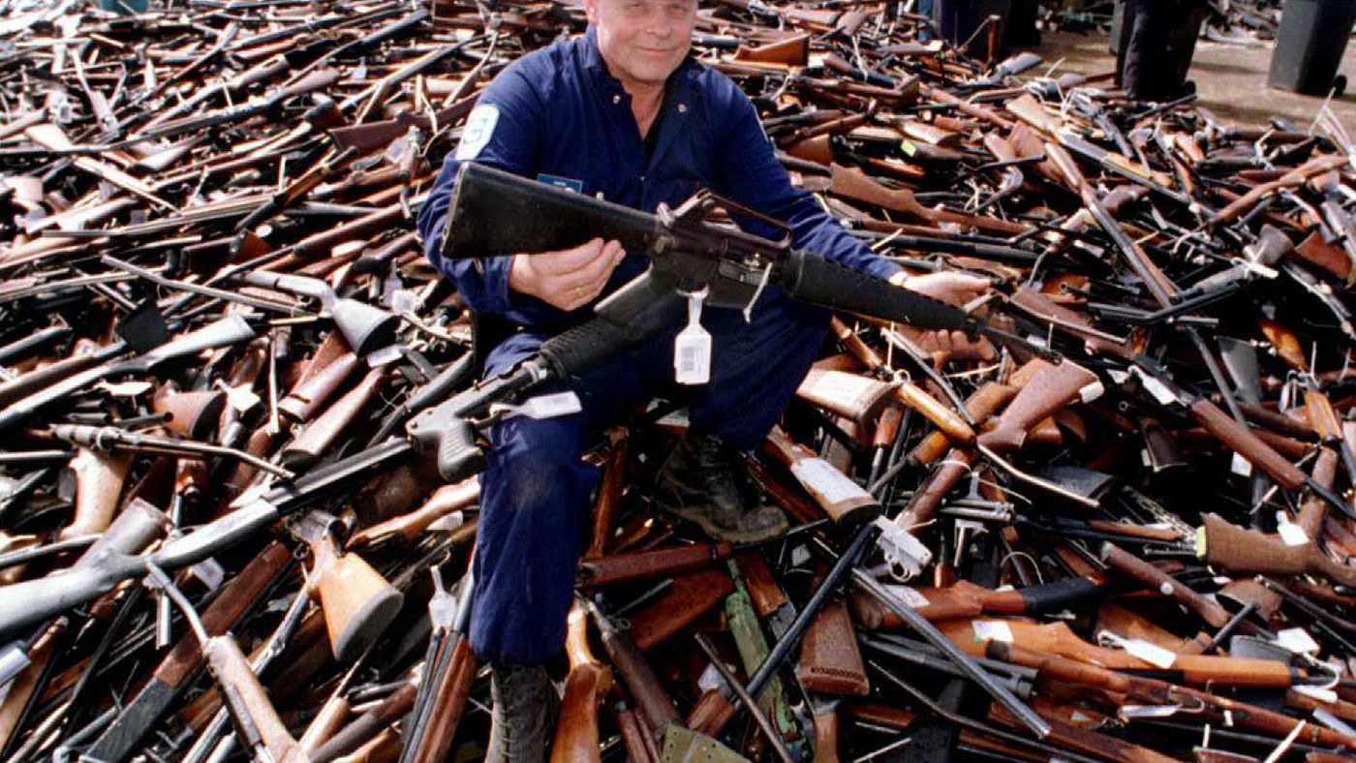
Dataset:
Limitations - file too large
Only used 2018 data
Could use any year from 2013 - 2018

Slide 7


Slide 8
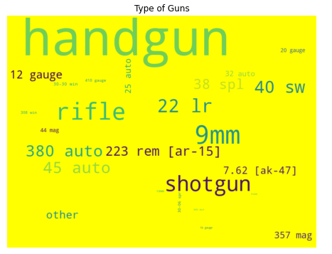
Type of Gun:

Slide 9
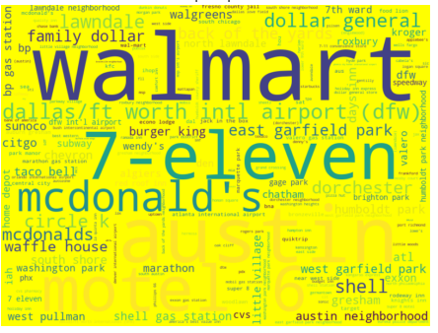
Locations:

Slide 10
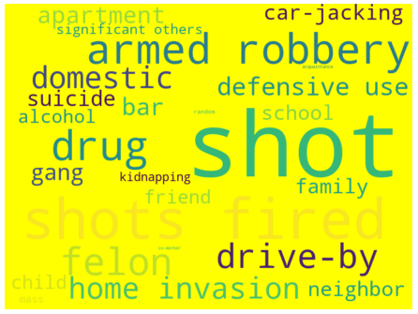
Key Words:

Slide 11

Where to begin?
Data Cleaning – Extensive Text
Feature Engineering
Text descriptors – Key words
The number of features became overwhelming
Eliminate non-essential features

Slide 12
‘Computational Limitations:’
The entire file was unable to upload to Colab.
Used dataset from 2018 as a compromise.
Encoding state and city was too much for CPU.
Therefore, state and city were eliminated.
Time to feed the beast.

Slide 13


Unsupervised Learning

Slide 14
Preliminary:
Establish ‘fatality’ as target
Standardize
Basic Clustering:
K-Means
Hierarchical - Agglomerative
DBScan
Gaussian Mixture Method (GMM)
Dimensionality Reduction:
PCA
T-SNE
UMAP
Process:

Slide 15
Results (n=13,803 incidents):
Clustering identified groups of 12-28 out of original 42.
K-Means and hierarchical clustering at 26 scored the highest when ground truth was not taken into account.
The dendrogram clearly shows 14 clusters.
Dimensionality reduction displayed a strong clustering of between 12-15 clusters.
The target value of ‘fatalities, was relatively equally distributed between relational clusters.

Slide 16
Future Investigation:
Incorporating Natural Language Processing(NLP) into dissecting the effects of specific key words would be the natural segue from this initial investigation.
Having further knowledge about the suspect would also be very informative as far as predictors of future incidents. Knowledge of the suspect’s criminal background, drug or alcohol abuse, level of education, mental health issues, and other indicators could be beneficial in detecting future acts of gun violence.

Slide 17
